Slide 1


Intellectual Property: What is it – and project working with Business?
Understanding of IP and the importance of protection , ownership issues and what is it you need to know and be aware of when working on projects with Business.
6th February 2017
Presented by: Paul Tiltman – Specialist Advisor (IP) – Research & Innovation and Guest Speaker: Rehman Noormohamed – Partner IP, Technology, Commercial & Competition (dwf law).
Intellectual Property
Copyright © University of Plymouth 2014 – All rights reserved

Slide 2
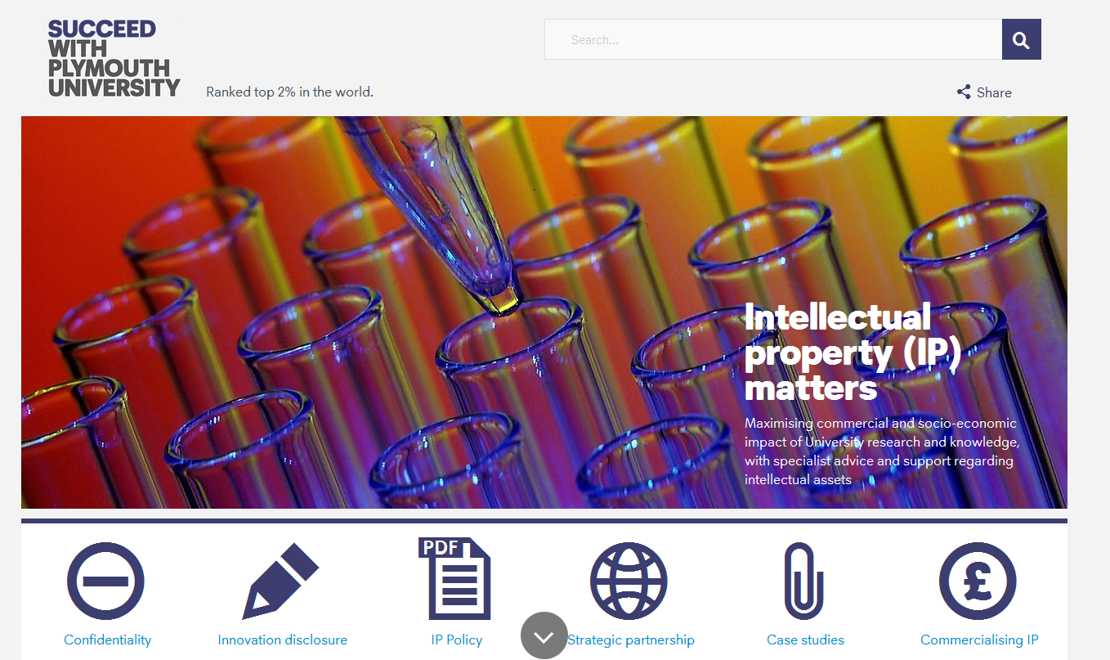
IP Matters: University IP resources for staff and students.
https://www.plymouth.ac.uk/research/support/intellectual-property
Intellectual Property
Copyright © University of Plymouth 2014 – All rights reserved

Slide 3
What are we going to cover?
1. Overview: Standard forms of IP
2. Some topical examples
3. University Policy – ownership
4. Working on External projects with Business.
Intellectual Property
Copyright © University of Plymouth 2014 – All rights reserved

Slide 4
Considerations
Freedom to operate
Whose IP – origination, importing and ownership/access
Intellectual Property
Copyright © University of Plymouth 2014 – All rights reserved

Slide 5
Freedom to operate
Will you copy, use or develop an existing idea?
Carry out a search to see if there are any rights that protect the same idea as your idea.
Intellectual Property
Copyright © University of Plymouth 2014 – All rights reserved

Slide 6
Definition (ref: Wikipedia)
Intellectual property (IP) legal concept which refers to creations of the mind for which exclusive rights are recognized.
Under intellectual property law, owners granted certain exclusive rights to a variety of intangible assets, such as musical, literary, and artistic works; discoveries and inventions; and words, phrases, symbols, and designs.
Common types of intellectual property rights (IPRs) include copyright, trademarks, patent, design rights, and can include trade secrets.
Intellectual Property
Copyright © University of Plymouth 2014 – All rights reserved

Slide 7
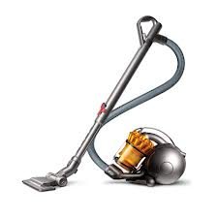
Intangible property: - Shape, design, inventions, technology, logo, graphics, name of cleaner
Tangible property:- the vacuum cleaner,
Intellectual Property
Copyright © University of Plymouth 2014 – All rights reserved

Slide 8

Presentation courtesy of the UKIPO
Registered design –
protecting the shape
Unregistered Design –
Any original shapes
Patents –
The working parts
Copyright –
Written instructions, engineering plans, sketches
Registered Trademarks –
Brand name, machines name, shape
Intellectual Property
Copyright © University of Plymouth 2014 – All rights reserved

Slide 9

Take note!
IPRs DO NOT PROTECT IDEAS per se
ie the concept of a vacuum cleaner
Copyright © University of Plymouth 2014 – All rights reserved

Slide 10
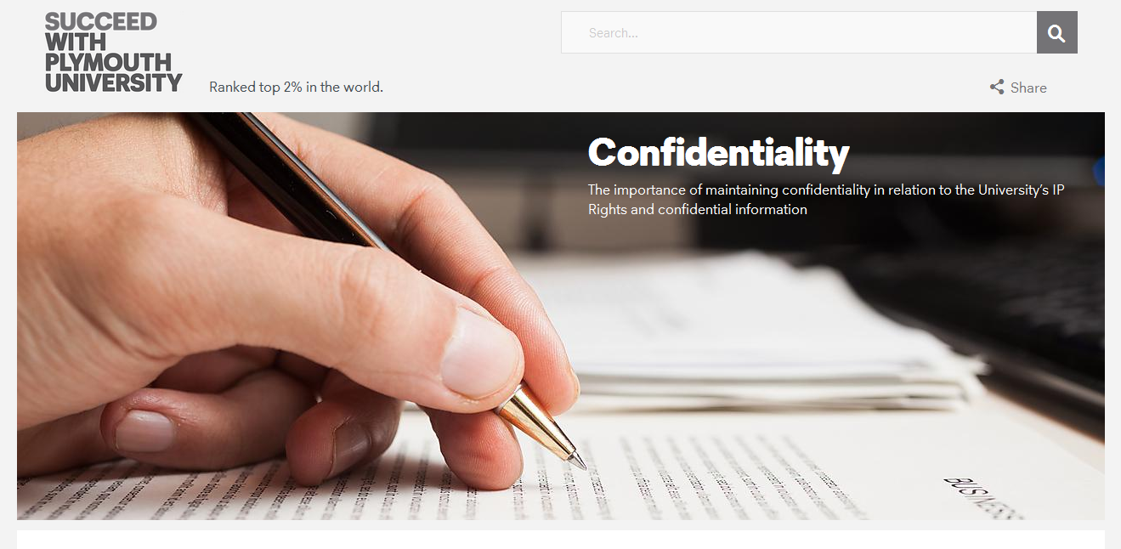
Keeping it safe - Confidentiality?
https://www.plymouth.ac.uk/research/support/intellectual-property/confidentiality
Intellectual Property
Copyright © University of Plymouth 2014 – All rights reserved

Slide 11
Specific Intellectual Property Rights
Intellectual Property
Copyright © University of Plymouth 2014 – All rights reserved

Slide 12
What is IP – Specific Intellectual Property Rights
Registered rights (requirement to fulfil criteria and pay fees)
Patents - inventions
Trademarks – logos, brands, names
Design rights – shape, look, feel
Unregistered rights (the come into existence on creation)
Copyright – literary, musical, artistic work and software
Unregistered Trademarks
Unregistered design rights
Intellectual Property
Copyright © University of Plymouth 2014 – All rights reserved

Slide 13
What is IP – Registered rights
Specific criteria must be met, fees must be paid
Patents
novel, inventive, industrial applicability
Trademarks
distinctive, not descriptive, not identical/similar to existing mark in same class
Registered Design
be new, have individual character, design can not be result of functionality
Intellectual Property
Copyright © University of Plymouth 2014 – All rights reserved

Slide 14
What is IP – Unregistered rights
Rights come into force on creation - specific criteria must be met
Copyright
Must involve original creation and skill
Unregistered Trademarks
distinctive, not descriptive, not identical/similar to existing mark in same class
Unregistered Design
Protects objects’ 3D outward appearance
It must be unique - it can not be ‘commonplace, everyday or ordinary’
Intellectual Property
Copyright © University of Plymouth 2014 – All rights reserved

Slide 15
What is a Patent
Legal protection for inventions
A patent for an invention is a monopoly right that is granted by the State to the inventor, giving the inventor the right for a limited period (normally 20 years) to stop others from making, using or selling the invention without the permission of the inventor.
When a patent is granted the invention becomes the property of the inventor (or employer), which - like any other form of property or business asset - can be bought, sold, rented or hired.
Patents are territorial rights; UK Patent will only give the holder rights within the United Kingdom and rights to stop others from bringing the patented products into the United Kingdom.
Intellectual Property
Copyright © University of Plymouth 2014 – All rights reserved

Slide 16
Patents
Protects inventions for products or processes.
3 Must’s - be novel; involve an inventive step & be capable of industrial application.
Novelty – the invention must never have been made public in any way, anywhere in the world.
Inventive step – the invention cannot be obvious to someone with a good knowledge and experience in the field.
Intellectual Property
Copyright © University of Plymouth 2014 – All rights reserved

Slide 17
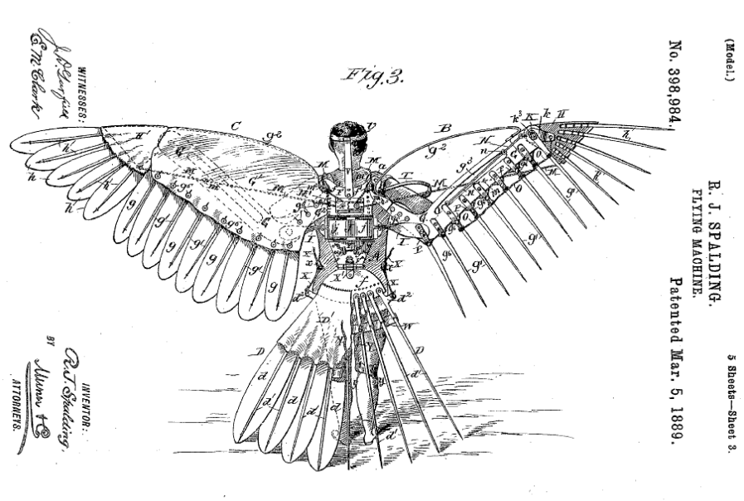
Patents (some examples)
Intellectual Property
Copyright © University of Plymouth 2014 – All rights reserved

Slide 18
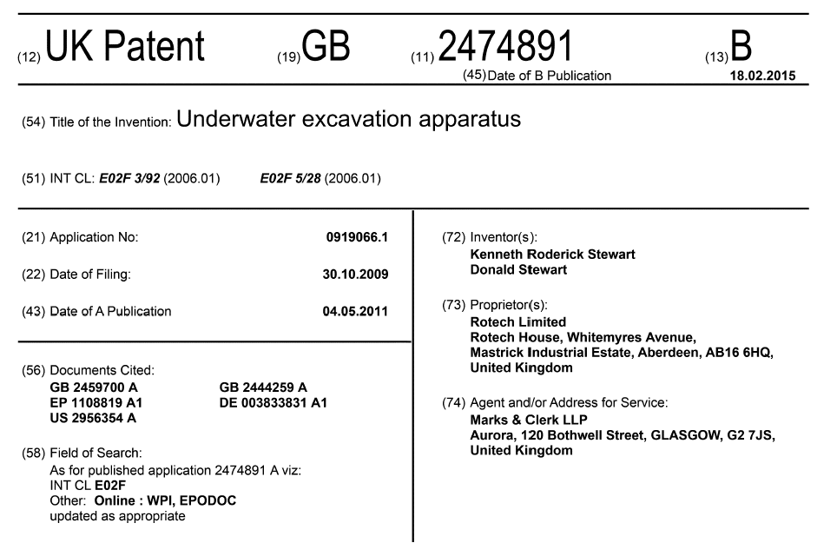
Patents
Published
Information
(Recent
UK Granted patent)
Intellectual Property
Copyright © University of Plymouth 2014 – All rights reserved

Slide 19
Patents prosecution
Need to apply for a priority filing to the UK IPO.
If want national coverage 2 options: PCT or direct application to national office of choice within 1 year of priority filing.
On grant of rights ‘Monopoly’ for 20 years from filing on payment of registration and annual renewal fees.
* Application prepared by a patent agent £1500-7500.To get protection across the globe can cost over £50000 and take between 4 to 10 years
Intellectual Property
Copyright © University of Plymouth 2014 – All rights reserved

Slide 20
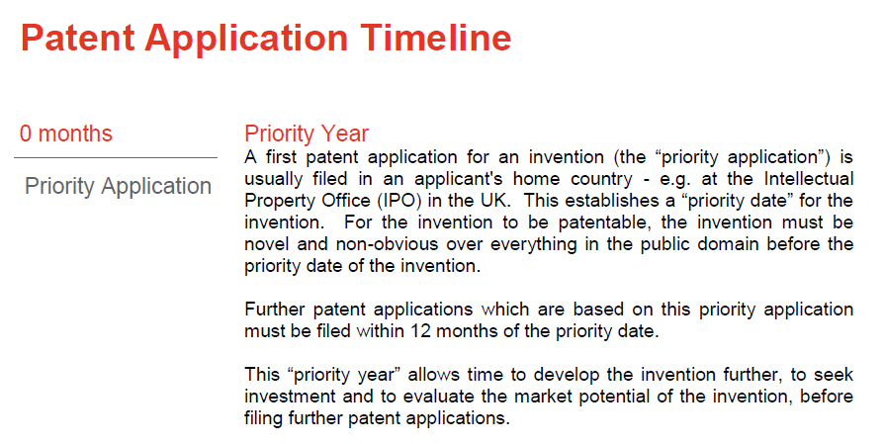
Intellectual Property
Copyright © University of Plymouth 2014 – All rights reserved

Slide 21
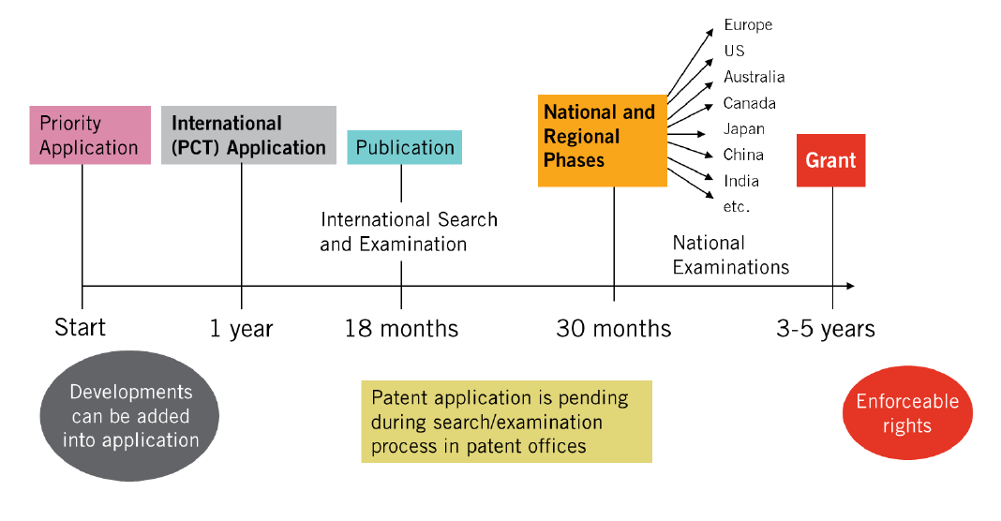
Intellectual Property
Copyright © University of Plymouth 2014 – All rights reserved

Slide 22
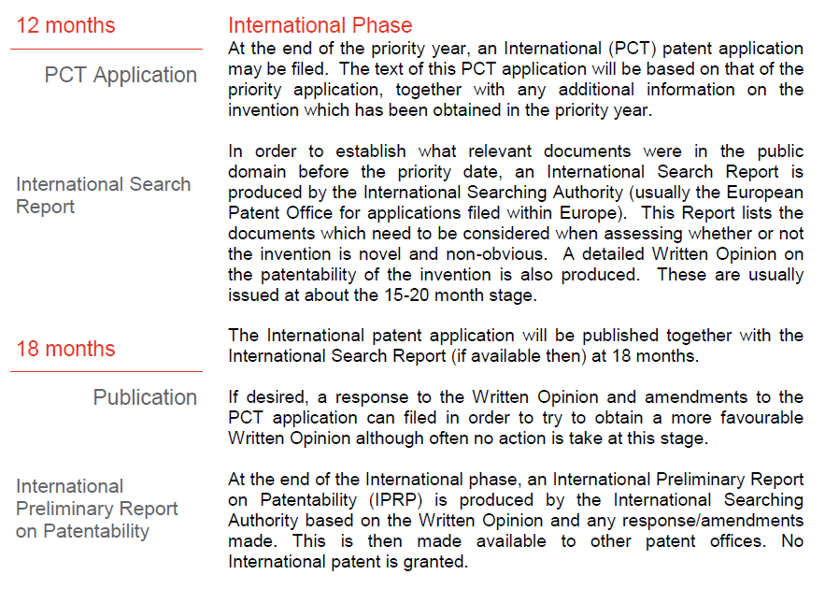
(Continued)
Intellectual Property
Copyright © University of Plymouth 2014 – All rights reserved

Slide 23
Intellectual Property
Copyright © University of Plymouth 2014 – All rights reserved

Slide 24
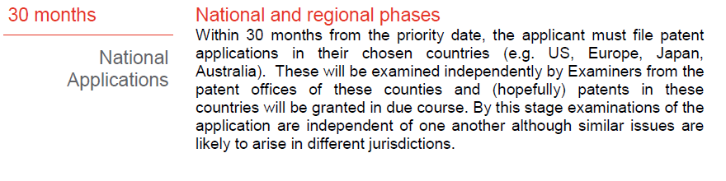
(Continued)
Intellectual Property
Copyright © University of Plymouth 2014 – All rights reserved

Slide 25
Intellectual Property
Copyright © University of Plymouth 2014 – All rights reserved

Slide 26
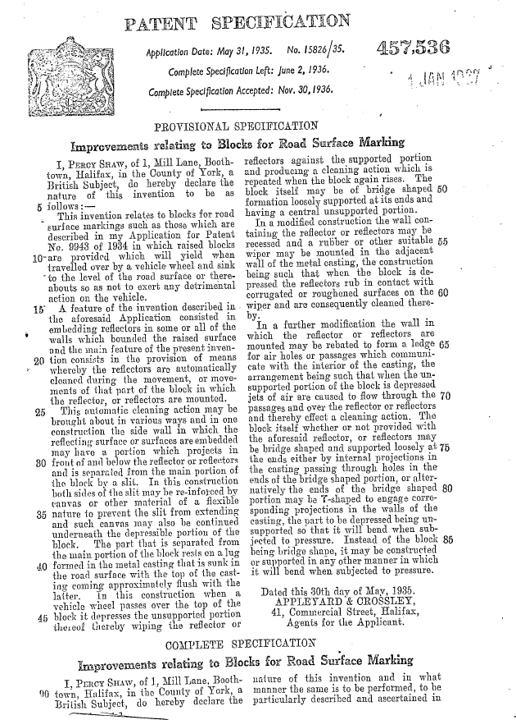
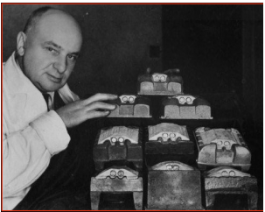
Patents
(some examples)
Intellectual Property
Copyright © University of Plymouth 2014 – All rights reserved

Slide 27
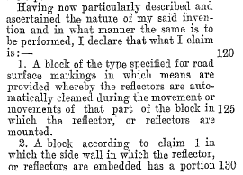
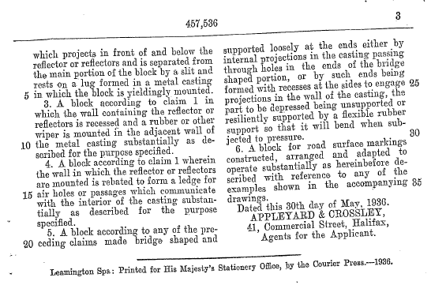
Patents
(some examples)
What is being
Claimed?
Intellectual Property
Copyright © University of Plymouth 2014 – All rights reserved

Slide 28
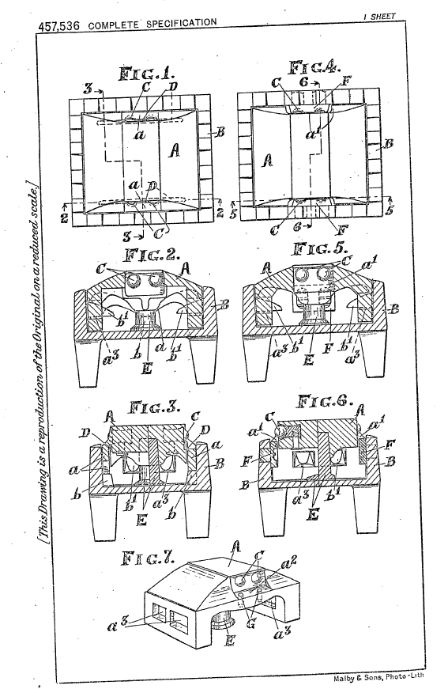
Patents
Percy Shaw – GB436290
Early in 1934 Percy decided that he needed patent protection and visited a firm of patent attorneys, Appleyards, in Halifax. Mr Appleyard advised that three separate patent applications were needed and they were filed on 3 April 1934. All three resulted in granted patents, including GB436290. On 15 March 1935 Percy set up Reflecting Roadstuds Limited, a company which still exists and is still located in Boothtown.
Shortly afterwards he applied to register the word “Catseye” as a trade mark and the registration is still in force; anyone can sell roadstuds but they cannot call them Catseyes ®.
Intellectual Property
Copyright © University of Plymouth 2014 – All rights reserved

Slide 29
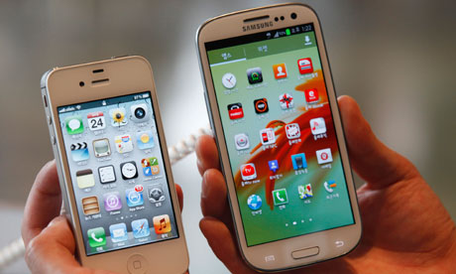
Apple iPhone violated by Samsung
$300bn+ smartphone market
Apple - 5 years and $5bn to develop a product.
Samsung “spent three months to bring a product to market”.
California jury found Samsung had infringed Apple’s patents and awarded Apple $1bn+ in compensation.
Copyright © University of Plymouth 2014 – All rights reserved

Slide 30
Apple iPhone violated by Samsung
$300bn+ smartphone market
Apple - 5 years and $5bn to develop a product.
Samsung spent three months to bring a product to market.
California jury found against Samsung and awarded Apple $1bn+ in compensation.
Judge Lucy Koh later denied Apple's request to ban the sale of the products found to be in breach. Koh ruled that Apple had failed to show any harm it may have suffered in the market was due to Samsung's infringement.
Copyright © University of Plymouth 2014 – All rights reserved

Slide 31
Copyright ©
Protects written works, diagrams, source code.
Protects the form, not the idea – design rights, patents.
For the life of the author plus 70 years.
Arises automatically once expressed in permanent form.
Must involve original creation and skill.
Database rights*
(protects independent works, data systematically or methodically arranged in electronic or other form).
Intellectual Property
Copyright © University of Plymouth 2014 – All rights reserved

Slide 32
Copyright © How copyright protects your work
Copyright prevents people from:
copying your work
distributing copies of it, whether free of charge or for sale
renting or lending copies of your work
performing, showing or playing your work in public
making an adaptation of your work
putting it on the internet
Intellectual Property
Copyright © University of Plymouth 2014 – All rights reserved

Slide 33
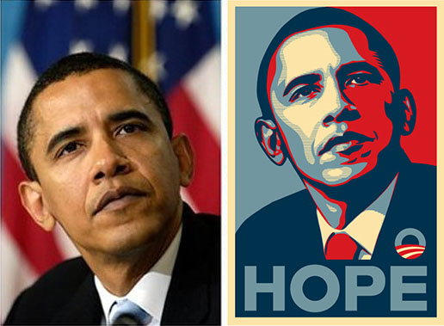
Copyright infringement?
Street artist Shephard Fairey created the Hope poster
Based the design on photo taken by Associated Press freelancer Mannie Garcia
Copyright © University of Plymouth 2014 – All rights reserved

Slide 34
Copyright infringement?
Street artist Shephard Fairey created the Hope poster
Based the design on photo taken by Associated Press freelancer Mannie Garcia
“Fairey defense” of fair use
The artist and the AP press came to a private settlement
Issue – Copy - whole or substantive?
Copyright © University of Plymouth 2014 – All rights reserved

Slide 35
Copyright © Exceptions to copyright
Non-commercial research and private study
Criticism, review and reporting current events
Teaching
Personal copying for private use
Parody, caricature and pastiche
FAIR USE
Intellectual Property
Copyright © University of Plymouth 2014 – All rights reserved

Slide 36
Unregistered and Registered Designs Rights
Unregistered Designs
Design right automatically protects the physical shape of something original.
Protects objects’ 3D outward appearance - decoration, lines, contours, colours, shape, texture
To benefit from Unregistered Design Rights it must be unique - it can not be ‘commonplace, everyday or ordinary’.
Intellectual Property
Copyright © University of Plymouth 2014 – All rights reserved

Slide 37
Designs
Registered design - via UK IP Office must:
be new (1 year grace period)
have individual character
design can not be result of functionality
renew every 5 years up to 25 years
Cost £60 for first design and £40 for every additional design
Application prepared by Patent or Design Agent £600-1500
Renewal fees £130, 210, 310, 450
International protection can be applied for within a year
Intellectual Property
Copyright © University of Plymouth 2014 – All rights reserved

Slide 38
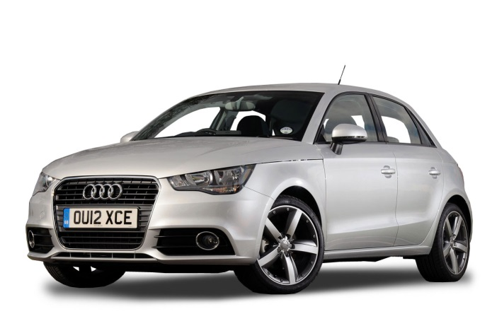
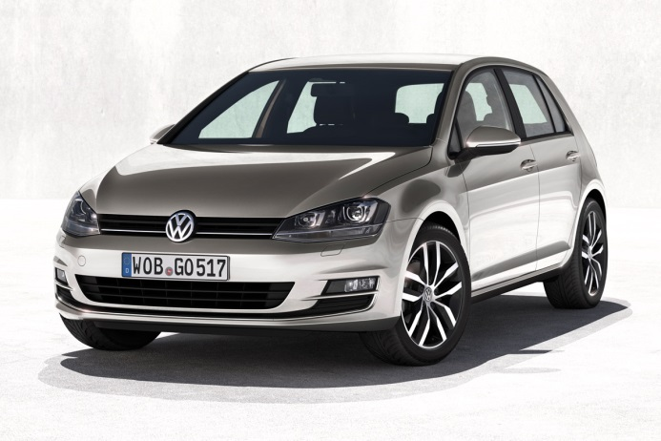
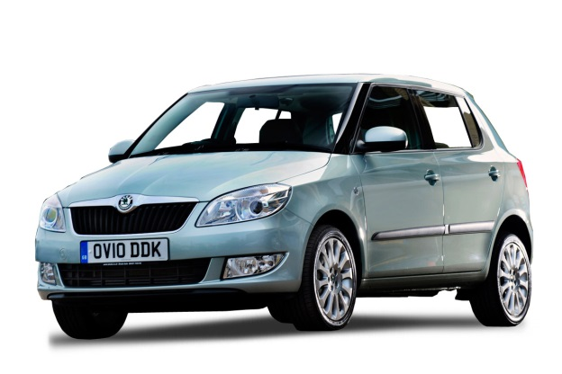



Trademarks
Copyright © University of Plymouth 2015 – All rights reserved

Slide 39
TRADEMARKS
For Businesses:
Trade marks are an essential marketing tool because they allow a business to identify itself to its customers, project an image and facilitate continued sales.
Once there is “good will” in a trade mark, has become well known and has developed into a ‘brand’ it drives customers to the products, and can allow the business to maximise its potential.
Trademarks with goodwill are often a companies most valuable asset
Intellectual Property
Copyright © University of Plymouth 2015 – All rights reserved

Slide 40
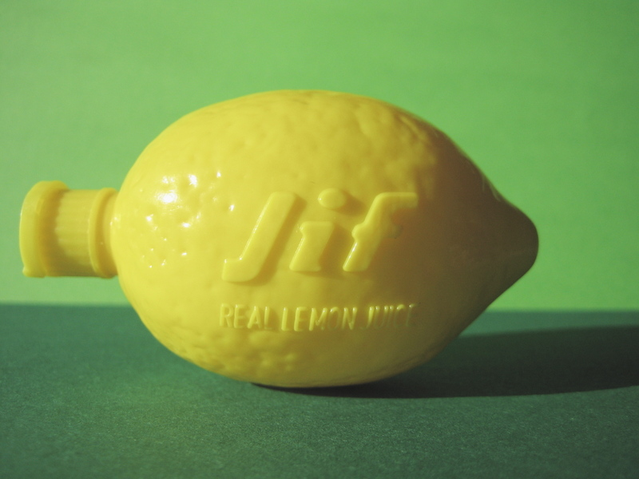
Unregistered Trademarks TM
There is no registration process and the company will build good will in the mark. Customers will overtime identify the Trademark with the product
Intellectual Property
Copyright © University of Plymouth 2015 – All rights reserved

Slide 41
Unregistered Trademarks TM - Infringement
You or your company must prove, through factual evidence, that
you have an established trade mark that has acquired a reputation and/or goodwill in the mind of the relevant public;
an offending trade mark has been, or is likely to be, confused with your established trade mark; and
your business under your established trade mark has been, or is likely to be, "damaged” by use of the offending trade mark.
Intellectual Property
Copyright © University of Plymouth 2014 – All rights reserved

Slide 42
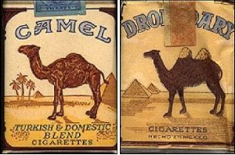
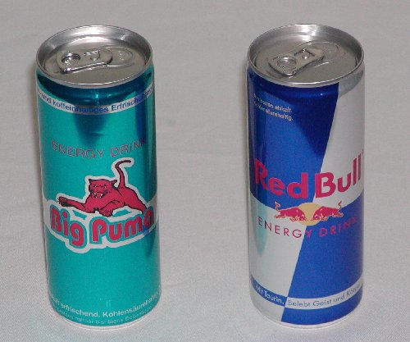
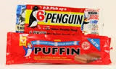
Unregistered Trademarks TM
- Passing Off
Intellectual Property
Copyright © University of Plymouth 2014 – All rights reserved

Slide 43
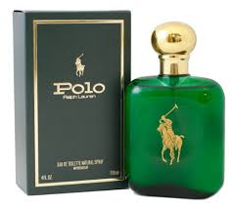
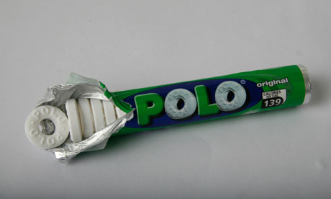

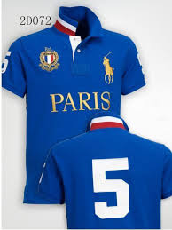
Registered Trademarks ®
Must specify class - 45 different classes for different goods and services
Intellectual Property
Copyright © University of Plymouth 2015 – All rights reserved

Slide 44
Registered Trademarks ®
a sign which can distinguish goods and services from those of a competitors
a sign = anything that can be described on paper in the application form
Registered via UK IPO (10 yr protection + 10 yr ad infinitum on payment of renewal fees) or unregistered
Registered trade mark must be:
Distinctive
Not descriptive
Not identical/similar to existing mark in same class
Costs – Application £200 and £50 for additional classes
Intellectual Property
Copyright © University of Plymouth 2014 – All rights reserved

Slide 45

Registered Trademarks ®
Intellectual Property
Copyright © University of Plymouth 2014 – All rights reserved

Slide 46
Registered Trademarks ®
“Bass Trademark No1”: ® 1876 and still alive
Intellectual Property
Copyright © University of Plymouth 2014 – All rights reserved

Slide 47
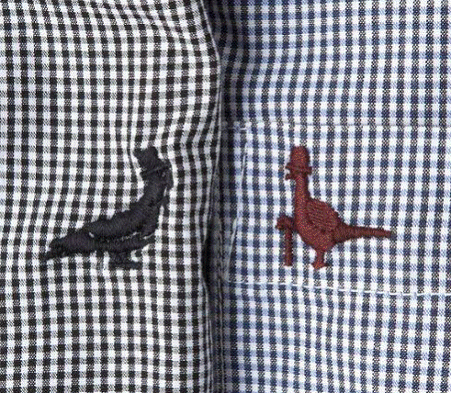

Registered Trademarks ®
Jack Wills vs House of Fraser
Who is the customer
Who is going to get confused
Intellectual Property
Copyright © University of Plymouth 2015 – All rights reserved

Slide 48
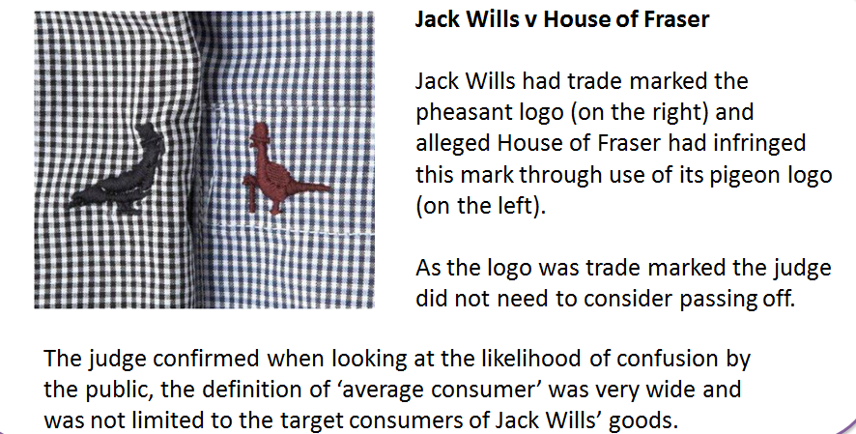
Registered Trademarks ®
Intellectual Property
Copyright © University of Plymouth 2014 – All rights reserved

Slide 49



To maintain a TM you have to keep it alive and stop it becoming generic?
Copyright © University of Plymouth 2015 – All rights reserved

Slide 50

Value of a trade mark
1978 – infringement of trademark $80,000
1986 - Apple Computer added MIDI and audio-recording capabilities to its computers - Apple Corps sue and ended any further development of the highly profitable Apple II line
1991 - Apple Computer agreed that it would not package, sell or distribute physical music materials. $25.5million
2007 - Apple Computer buys out Apple Corps' trademark rights for a total of $500 million.
Copyright © University of Plymouth 2014 – All rights reserved

Slide 51


?
Trade marks
Confidentiality?
Patent rights
Copyright
‘Know-how’
IP Jigsaw?
Design rights
Image Courtesy of
Intellectual Property
Copyright © University of Plymouth 2014 – All rights reserved

Slide 52
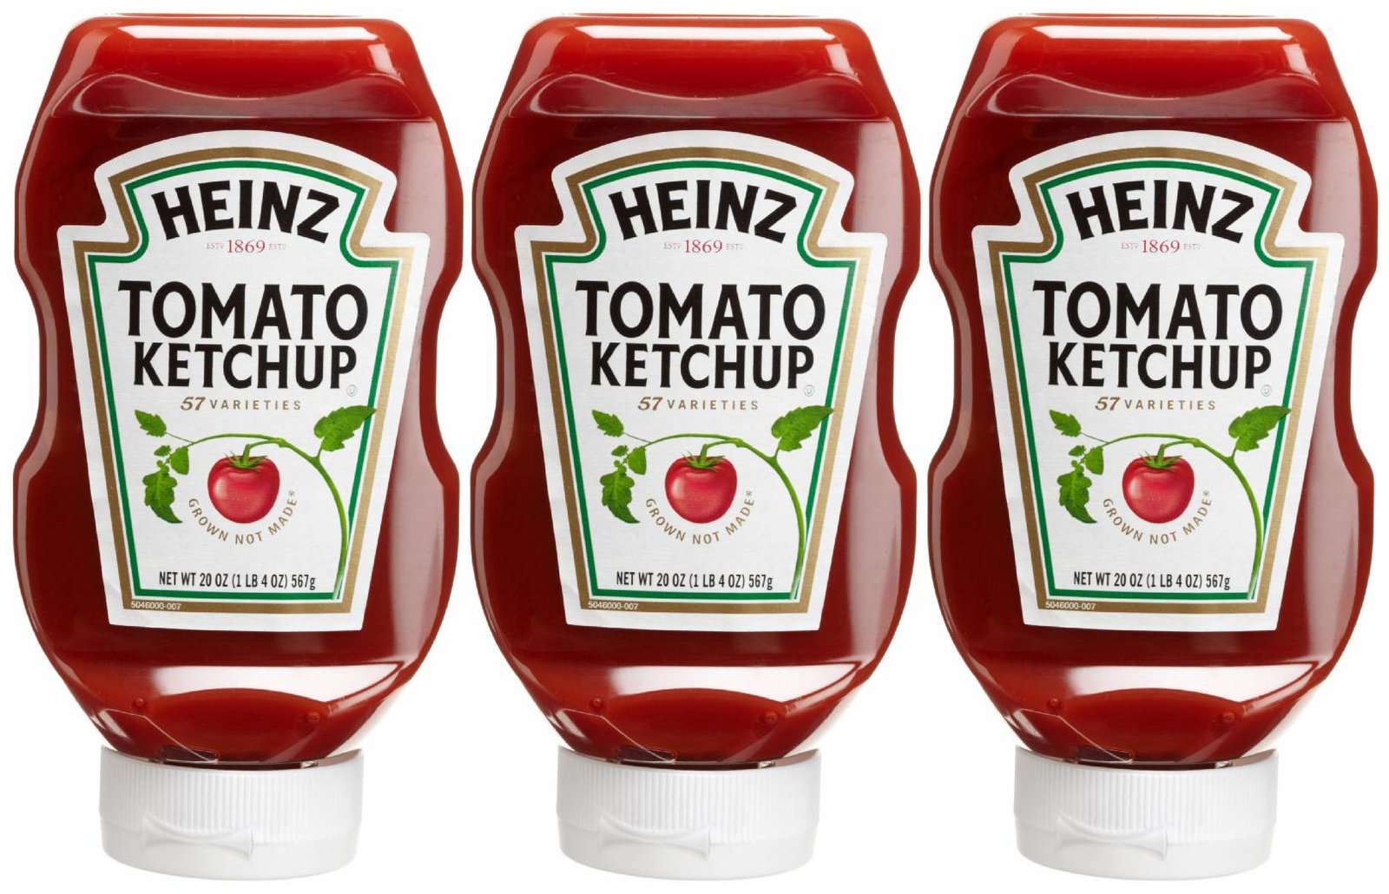
Presentation courtesy of the UKIPO
What IP
Intellectual Property
Copyright © University of Plymouth 2014 – All rights reserved

Slide 53
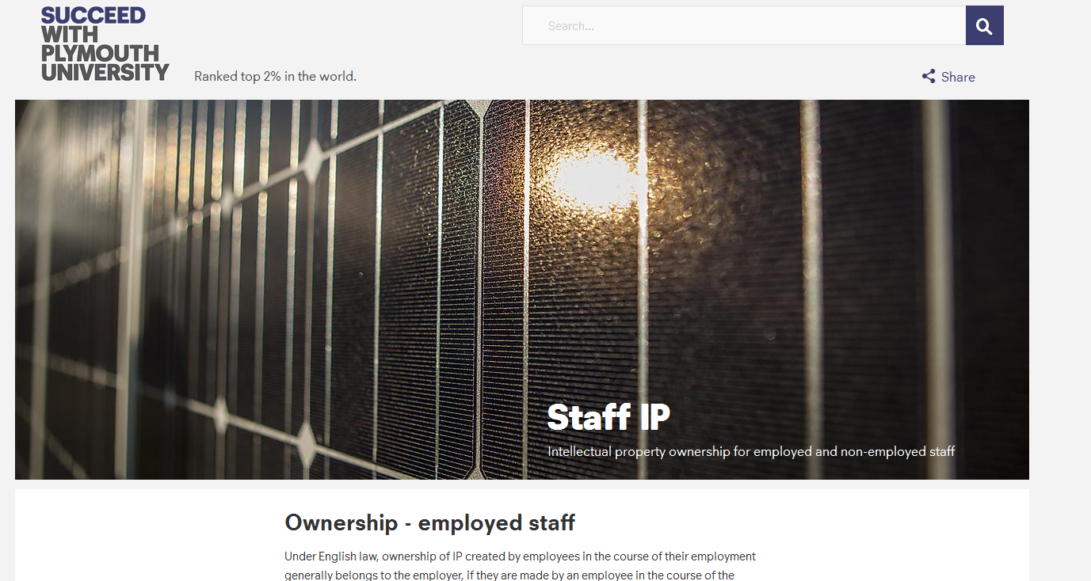
IP OWNERSHIP - https://www.plymouth.ac.uk/research/support/intellectual-property/staff-ip
Intellectual Property
Copyright © University of Plymouth 2014 – All rights reserved

Slide 54
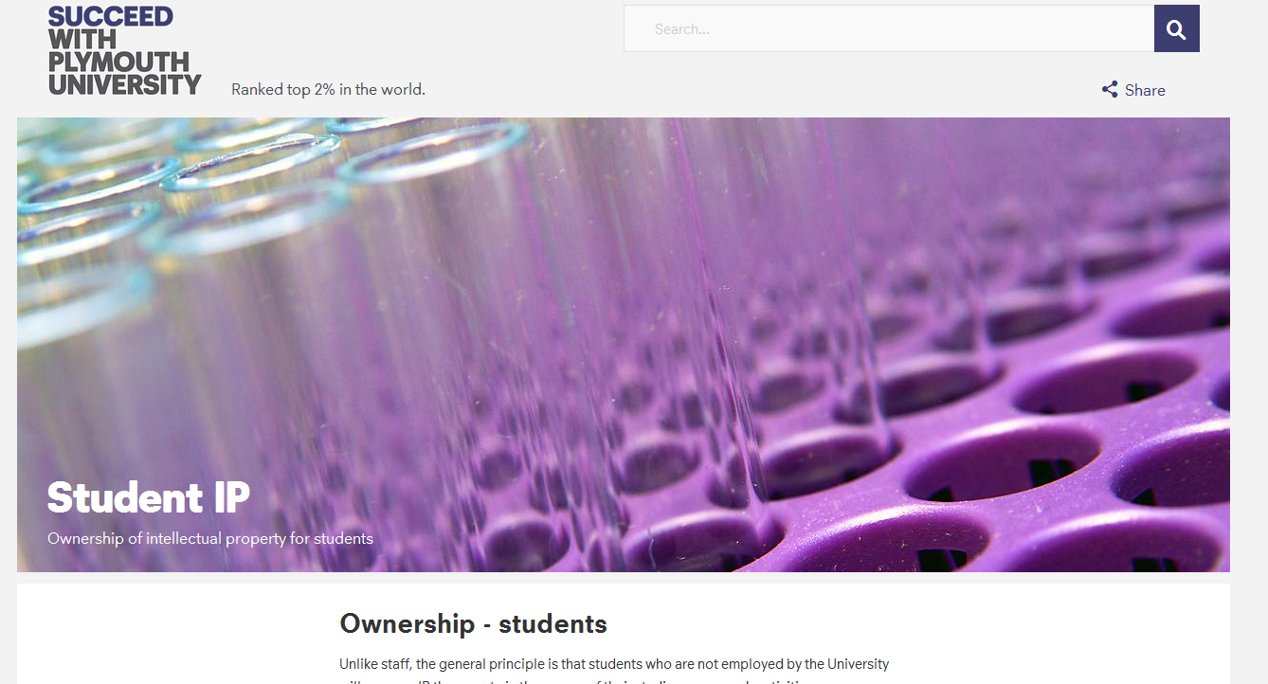
IP OWNERSHIP - https://www.plymouth.ac.uk/research/support/intellectual-property/student-ip
Intellectual Property
Copyright © University of Plymouth 2014 – All rights reserved

Slide 55
Working on external projects with Business – Your Projects!
(What do you need to consider/what do you need do –if anything?)
Rehman Noormohamed (DWF Law)
Intellectual Property
Copyright © University of Plymouth 2014 – All rights reserved

Slide 56
1. What to be aware of: Headline Issues…
Planning ahead
Risks & Mitigation
Protecting yourself
Protecting the other-side?
What constitutes a contractual relationship (5 elements)?
2. Plan your discussion carefully.
Intellectual Property
Copyright © University of Plymouth 2014 – All rights reserved

Slide 57
3. Protecting yourself/protecting the other-side
Confidentiality/Non-disclosure
NDA/CDA
Intellectual Property
Copyright © University of Plymouth 2014 – All rights reserved

Slide 58
4. High-level terms (HoT)/Terms of Engagement
Defining Scope
Assumptions
Rights and Obligations
IP Rights – protection, owning and exploiting
Terminology – Yours/Theirs and Newly created IP
Agreeing – Formal v email v verbal
Intellectual Property
Copyright © University of Plymouth 2014 – All rights reserved

Slide 59
5. A Contractual relationship (5 elements)?
Offer
Acceptance
Consideration – Recognition/Reward (Equitable)
Experiential
Payment – monies/other
Intention to create a legal relationship
Certainty
6. Evidence – “Keep a daily log”
Intellectual Property
Copyright © University of Plymouth 2014 – All rights reserved

